Slide 1
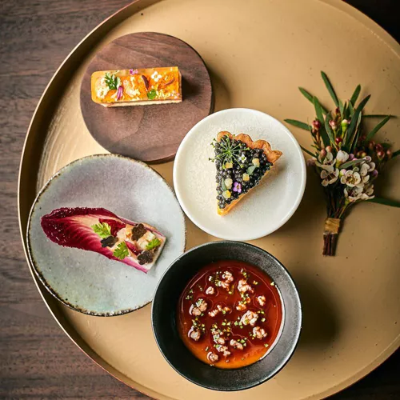
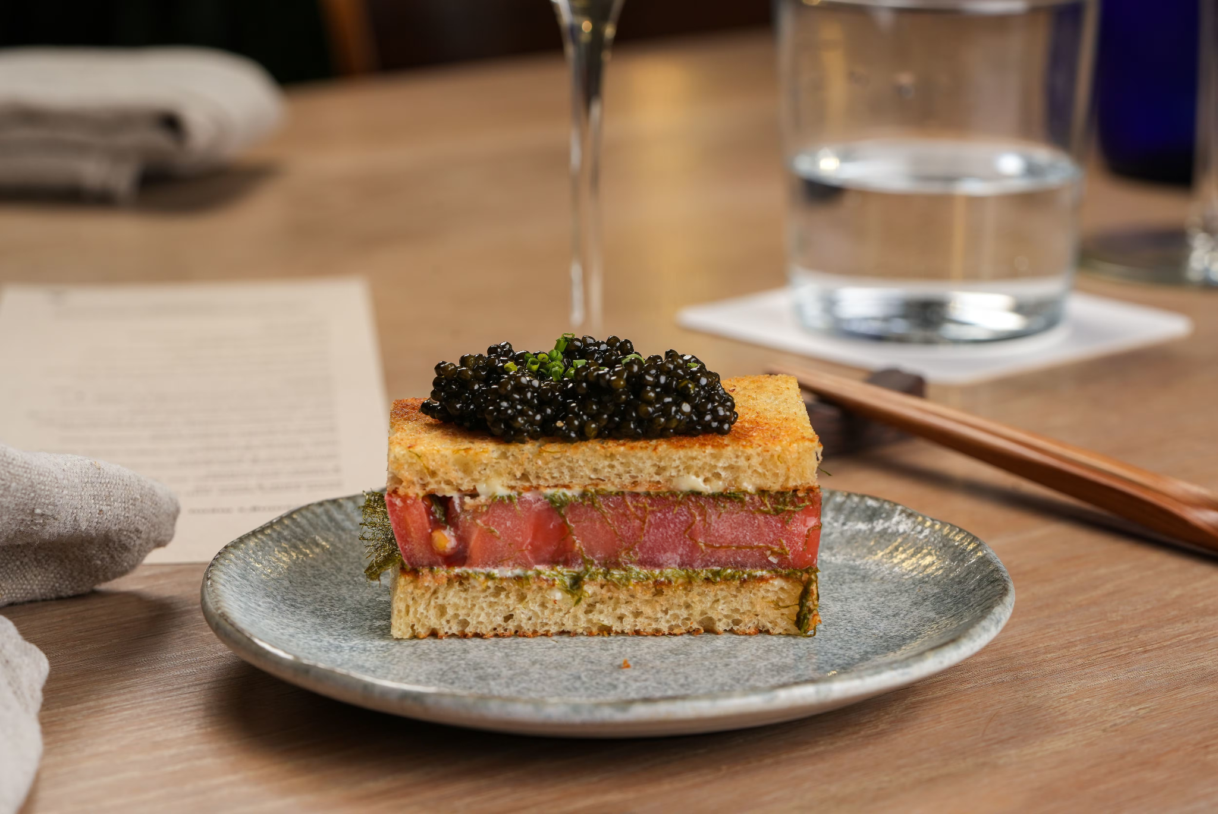
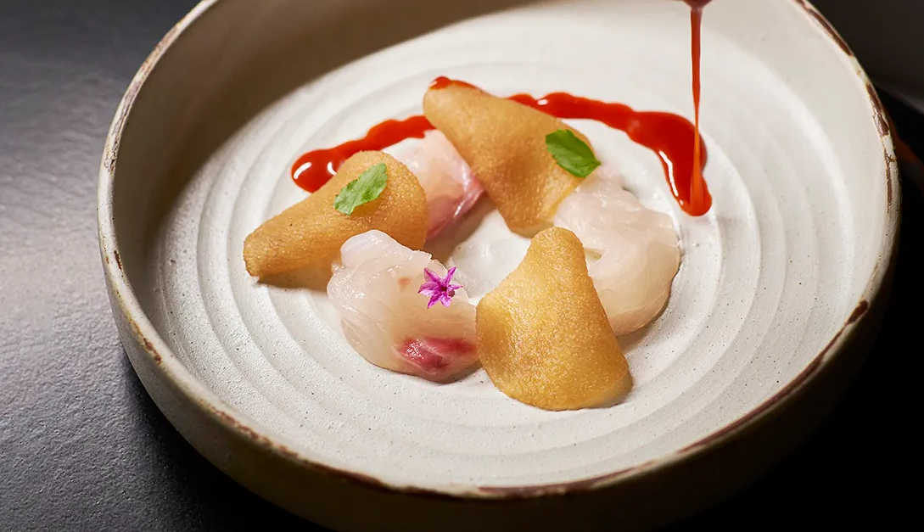
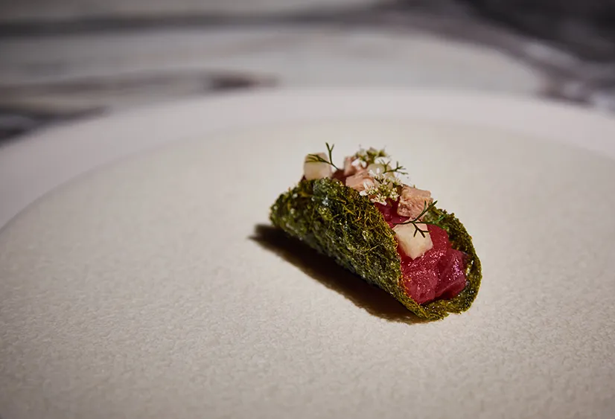

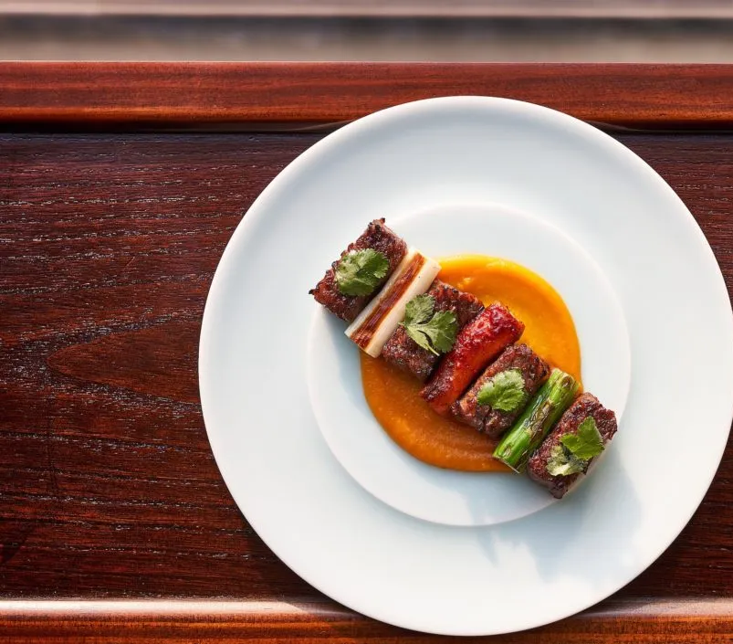
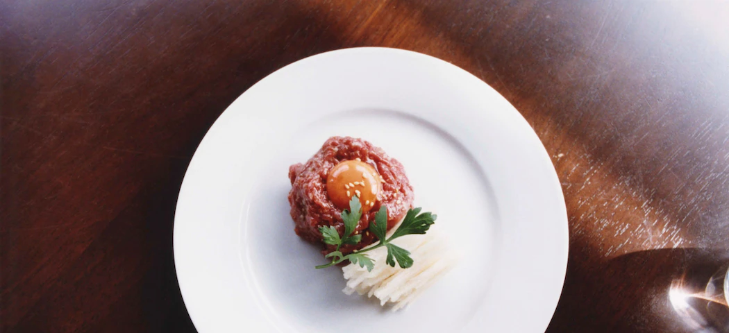
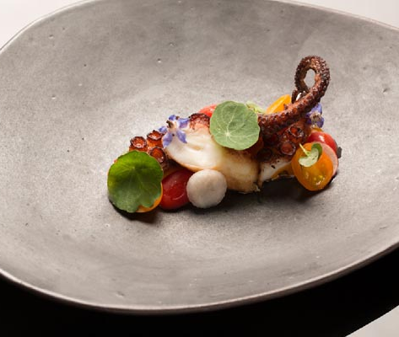
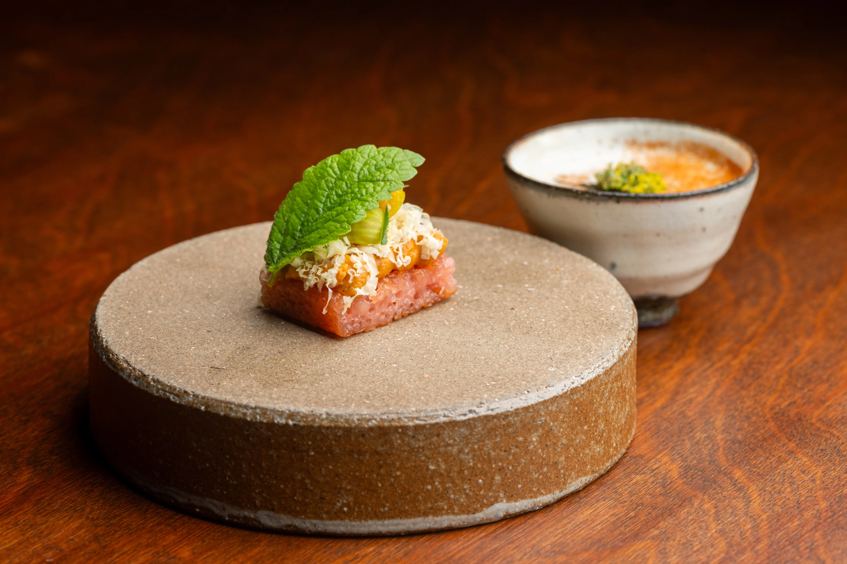
Notes:
Welcome to our presentation today, we thought of a korean fine dining restaurant, near Sloane Square.

Slide 2
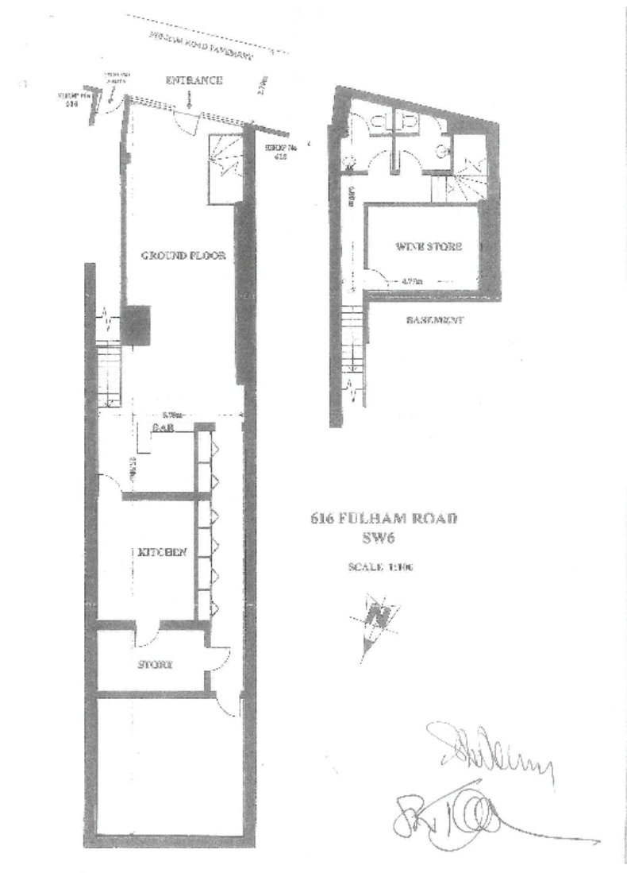
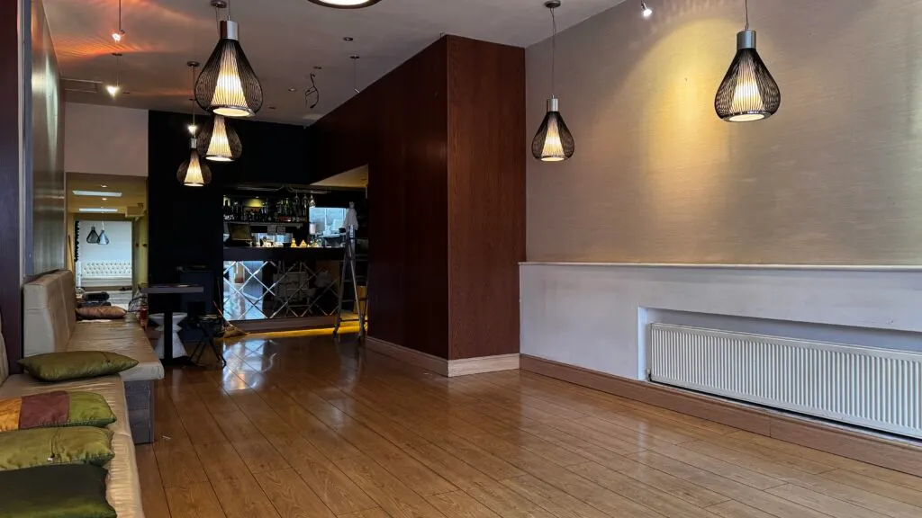
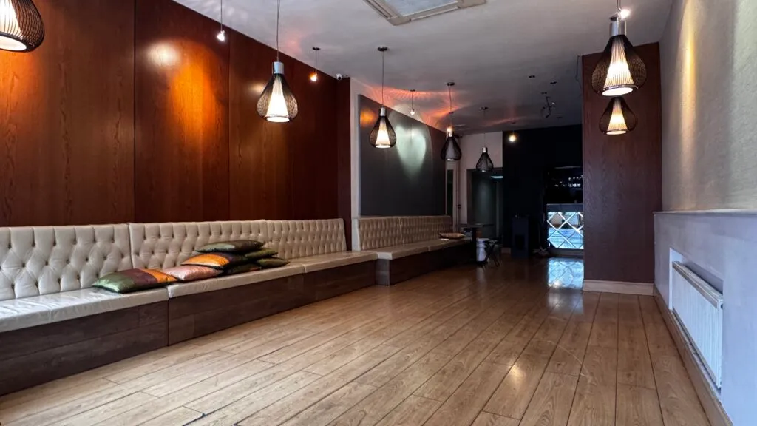
Design
Notes:
The floor plan is a two-level design that maximizes a narrow London footprint by moving the wine store and restrooms to the basement. This clears the ground floor for a focused dining area featuring an open kitchen and a long chef’s counter. The central element is a stone rock fountain, which replaces the need for an outdoor courtyard. It acts as a structural anchor, using the sound of water to provide natural white noise that masks street sounds. This stone feature breaks up the modern lines of the building and grounds the interior in a raw, elemental aesthetic.

Slide 3
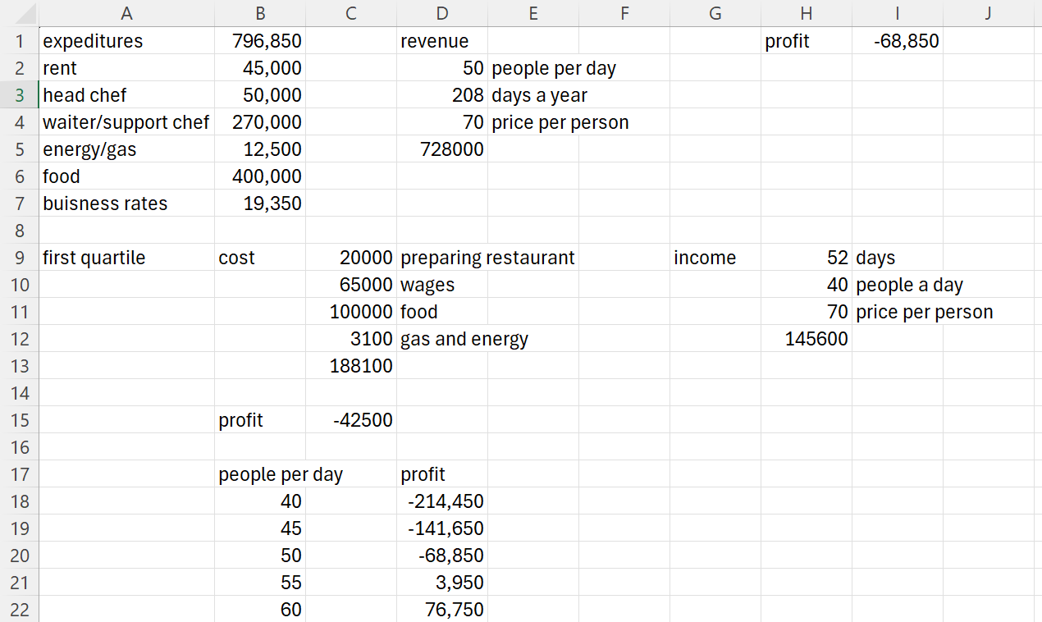

Financial
Property - Fulham Road, London SW6, 1,175 sq. ft
Total Budget: 500,000
Total Cost: approximately 800,000
Notes:
These are our finances, most of our costs are paying staff and food. We found the lease on a real property in fulham which is a two minute walk form the nearest tube and can seat 60 people. We are expecting to charge around £70 per person. The main factor for how much we will make is the number of people we serve each day, if we only manage 40 per day we will lose over 200,000 pounds in a year, however if 60 people ate each day we would make over 75,000 pounds. We are setting aside around 20,000 for setting up because there is a chance we fail kitchen inspection and have to refurbish it. We expect to lose about 40,000 in our first quartile.

Slide 4
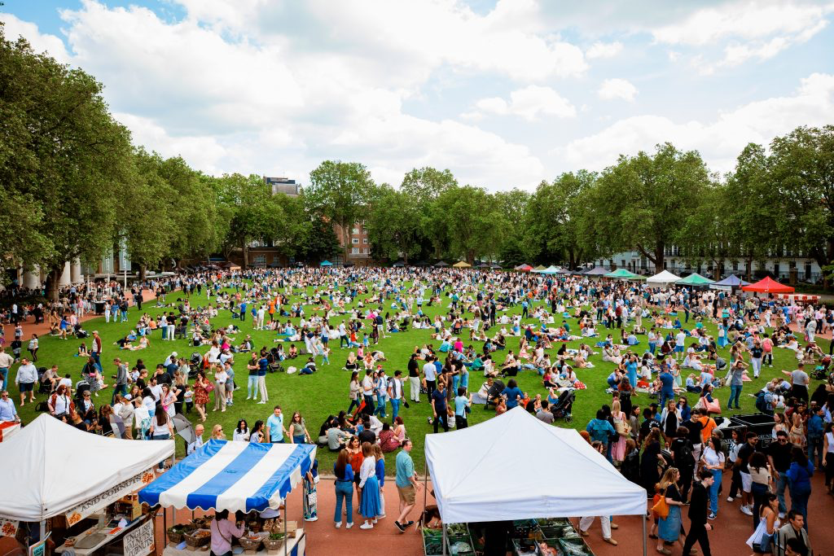
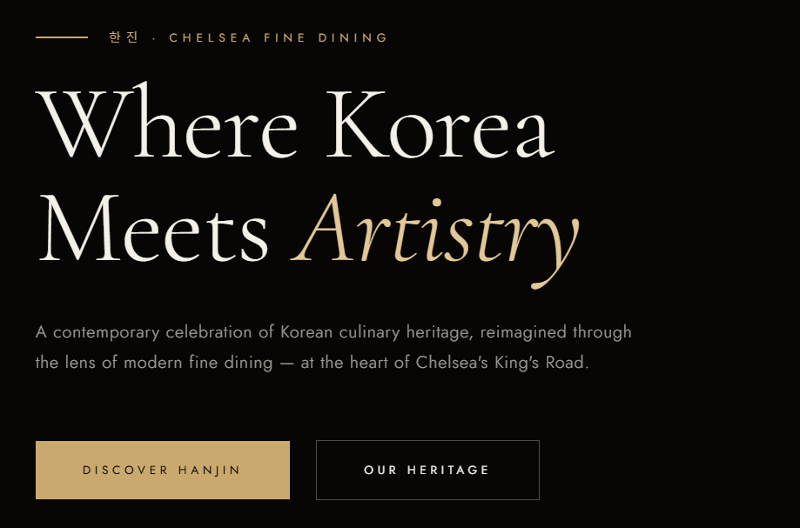
Marketing
Marketing Pre Opening
Pop-up stall, street food based to build the brand
Duke Of York square
Anonymous for first month
Drive hype through social media, influencers
Website:
https://sites.google.com/stpaulsschool.org.uk/koreanfinedining/home?authuser=1
G A M T A E.
Notes:
For our marketing projects, we have carefully thought out how to maximize our exposure before and during the lead up to the opening day of Gamtae. We are planning to have a pop up within duke of york square market. This takes place every saturday and is relatively popular for many people of the younger population of London. This is a useful place to advertise our brand BEFORE opening to people who live nearby to the restaurant location, and to ensure that our business receives enough exposure preceding the opening day so that people know of us.
One way in which we can drive hype and anticipation for our opening day is through the use of mystery and animosity to increase interest and curiosity in out business. For the first month in the Duke Of York market, we will not disclose our name to our customers, in order to create interest in our food, inviting more people to come to try our food. With this unique use of provocative marketing, to drive interest in our business, we believe that we can set up the restaurant for success, especially in the first 6 months, where many businesses lose money in.

Slide 5

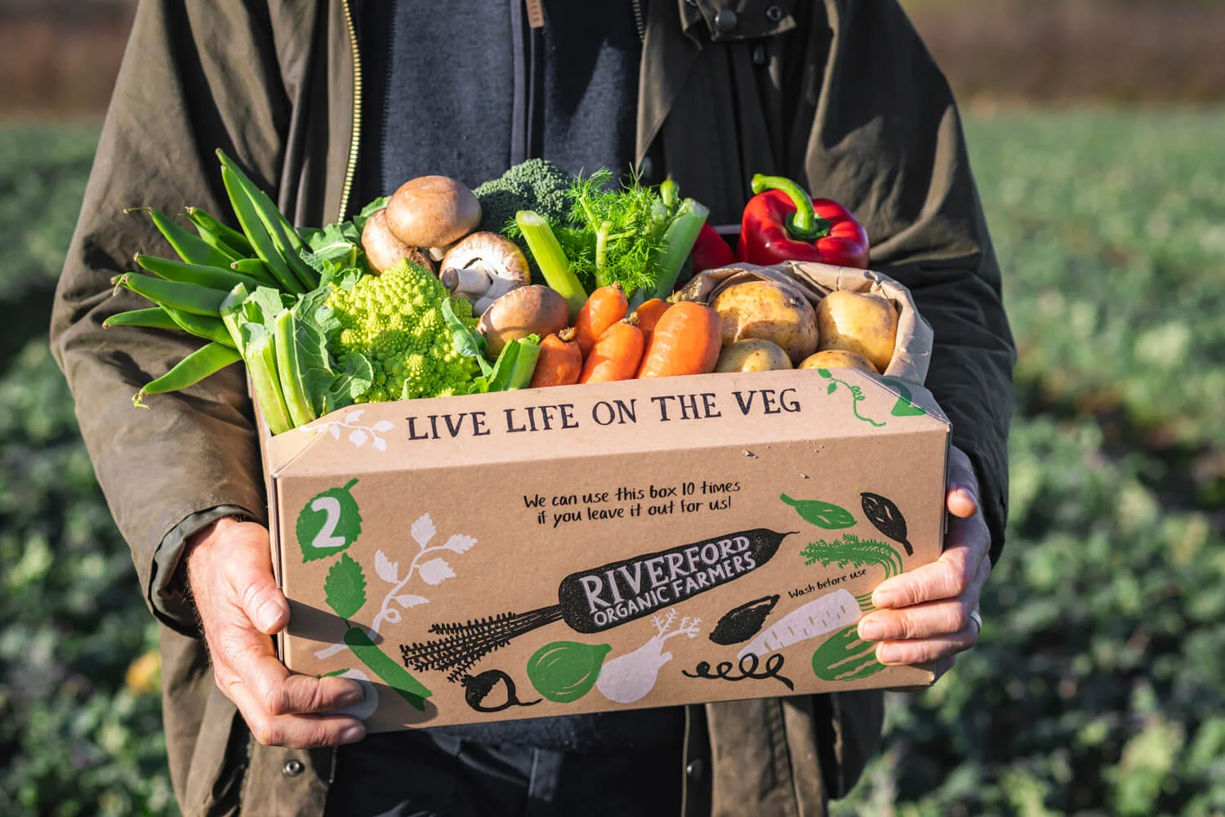

Sustainability

Slide 6
SWOT analysis
Strengths:
Elevate Korean cuisine to a new level and fall in line with trends
Korean food already resonates with young people
Weaknesses:
Fierce competition in the wider market of Korean cuisine
Opportunities:
Fast-spreading influence on social media
Targets wide audience of any age, but especially young generations.
Threats:
Loss of money in starting year.
Notes:
STRENGTHS
Lucas:
The strengths of our business are undeniable, as we raise the idea of consuming korean food to a greater standard. Korean cuisine in modern culture is often associated with vibrant trends and energy. However we seek to really savour each moment in a fine dining environment, while retaining the vivid and brilliant feel.
WEAKNESSES
Michael:
The extremely saturated market leads fierce competition. We view drawbacks not as issues, but as a chance to strive, invent and experiment. This pushes us to find innovate in times of high demand, and Gamtae will be a frontrunner, driving the industry of fine dining and paving the way for new ideas, such as our more refined yet leisurely approach.
OPPORTUNITIES
Lucas:
The idea of popular korean food is already established among younger generations, so our success has the chance to have a lasting impact. Also, we can use social media to be a cost-friendly yet efficient way to market our brand.
THREATS
Michael:
The starting year may be rough, but we seek to have a longer term impact.
Also, some may believe that our fine-dining experience is not as exciting as alternatives such as Korean BBQ, but we are what London is missing, and this is how one can fully appreciate the culture.

Slide 7
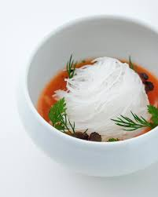
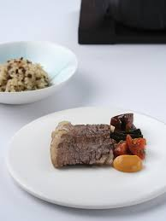
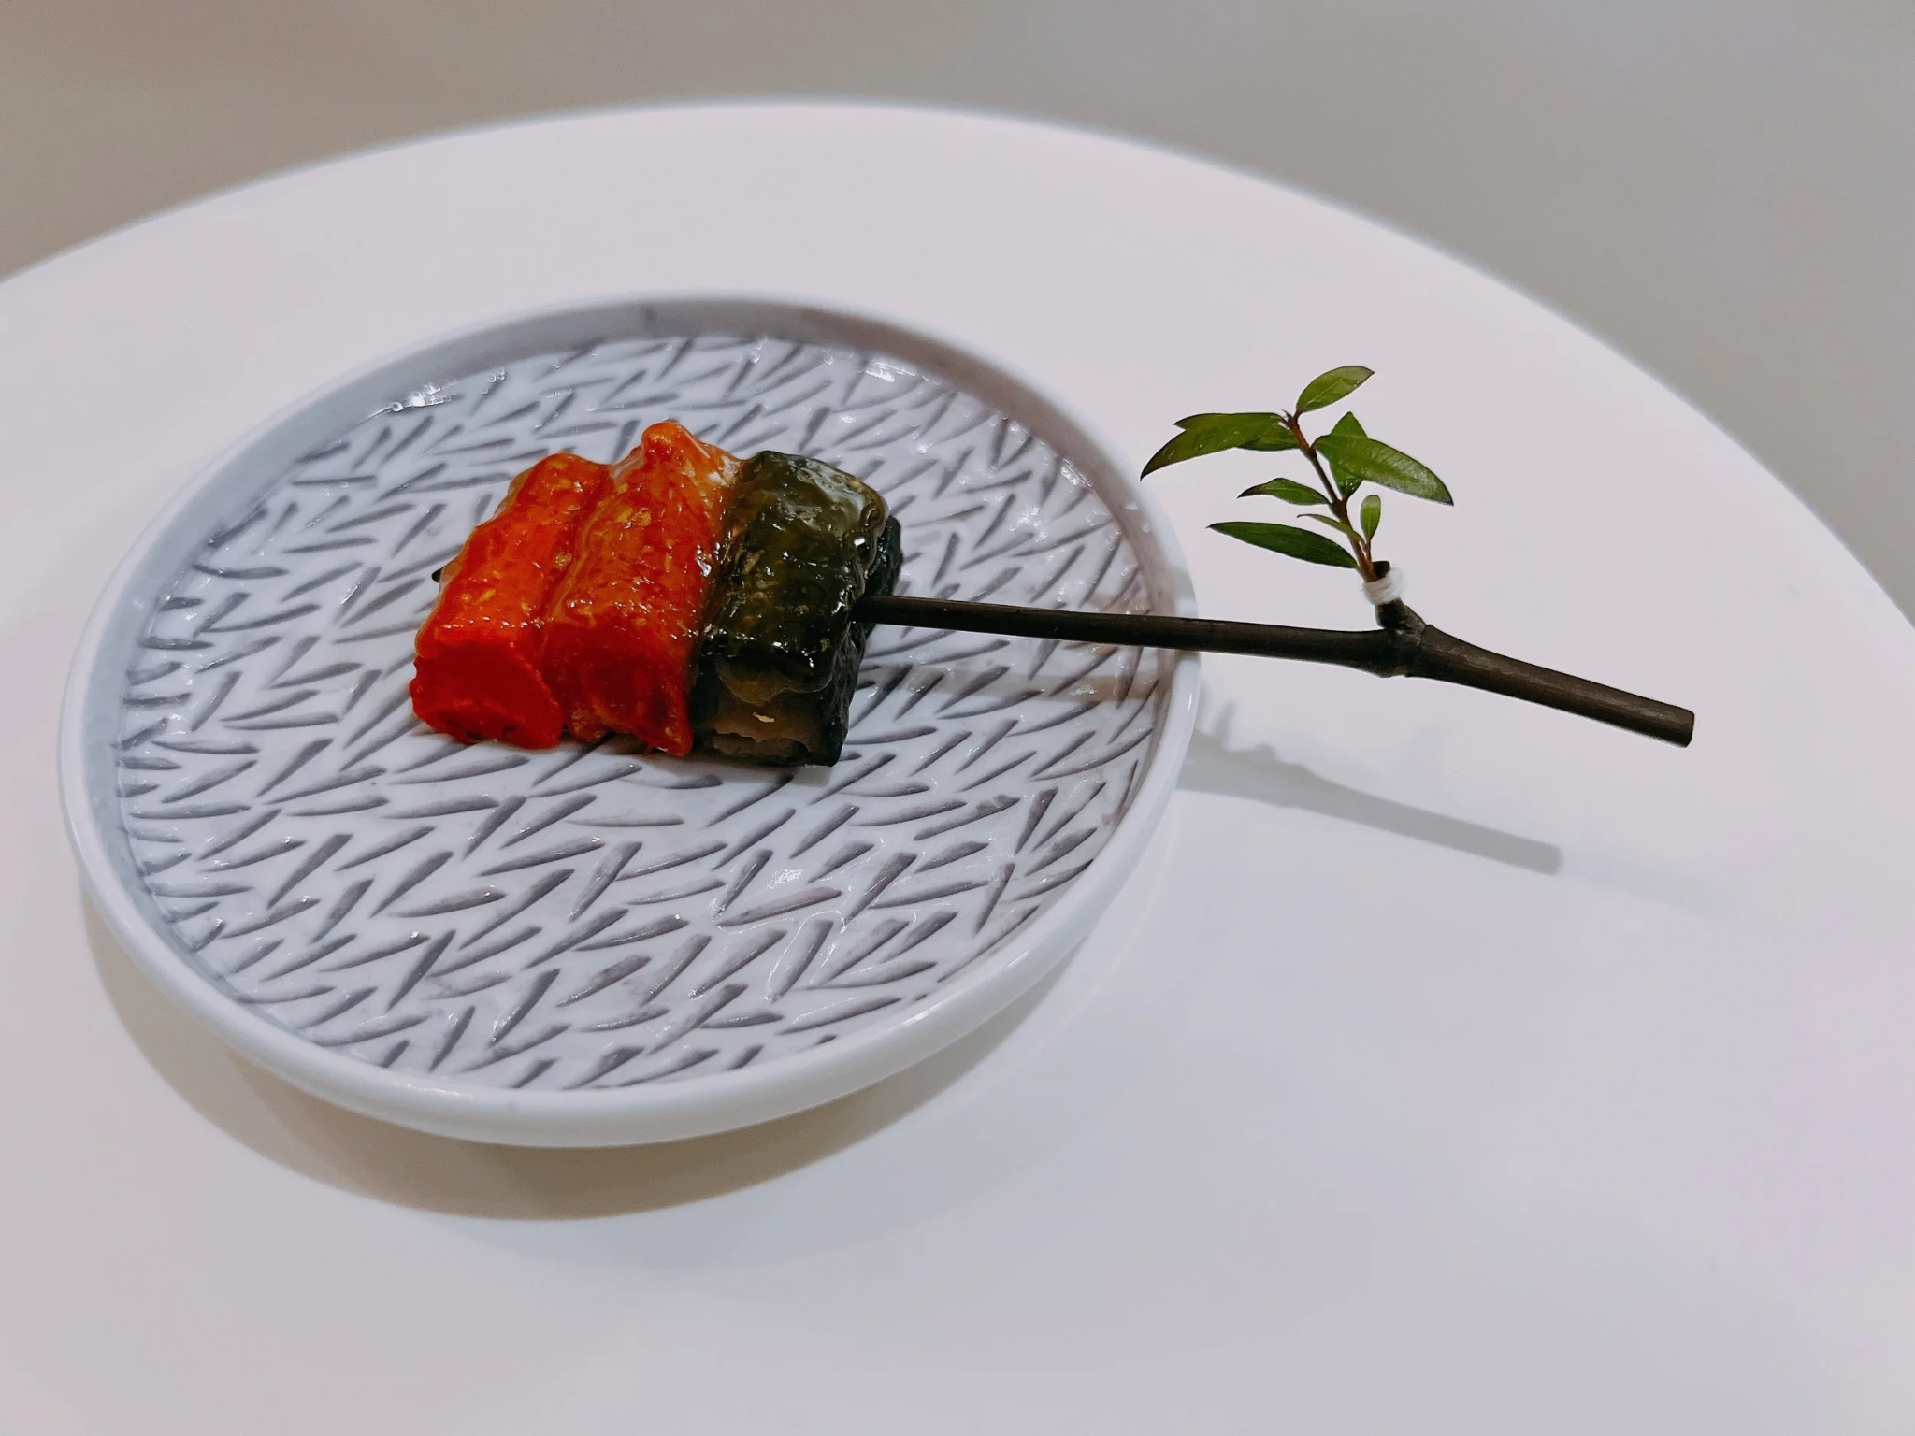
LUNCH SET MENU (SEASONAL)
bigfin squid in cold broth
ruby snapper & spring green
lamb loin, soybean, blood orange
gosari rice cooked in cast iron pot
“Suyuk” short rib
sand pear granita, ginger, honey
Notes:
This is our lunch set menu, as you can see, we would like to keep it minimalistic and a set menu - it changes seasonally based on ingredients and tastes.

Slide 8
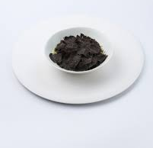
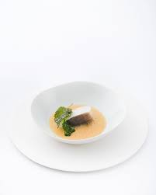
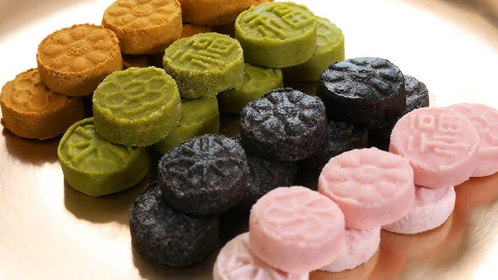
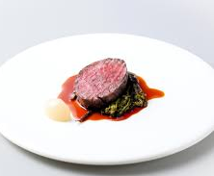
DINNER SET MENU (SEASONAL)
toasted sesame tofu with seaweed oil
tilefish & spring green yellow
chicken in ginseng, shiitake broth
butterfish, anchovy, cherry
ember roasted acorn noodle
Hanwoo, gosari, gochujang
pine nut & gamtae. dasik
Notes:
Same here with the dinner menu

Slide 9
Korean fine dining , w i t h a n i m p a ct
Notes:
The name Gamtae, meaning sweet seaweed, is a wild seaweed found off the coast of Korea. What makes it unique is its harvesting method. Unlike other seaweeds, it cannot be farmed en masse, instead, it must be hand harvested from tidal mudflats, giving it an authentic and distinct taste and smell. This is what we at Gamtae Fine Dining want to achieve. Distinctness and authenticity. I hope you enjoyed our pitch, thank you very much for listening.

