Slide 1


s.a.h.o
CEOs: Thomas and Scout

Slide 2

Meet the team at S.A.H.O (South African HOme cooked)
Menu Innovators, and Website Analysts: Henry, Nathan and George
Heads of Advertisement: Maya, Pippa and Daniel
Financial Coordinators: Winston and Valdemar
Sustainability Lead: Charlie
Aesthetics Managers: Ava, Ananya and Emmeline

Slide 3
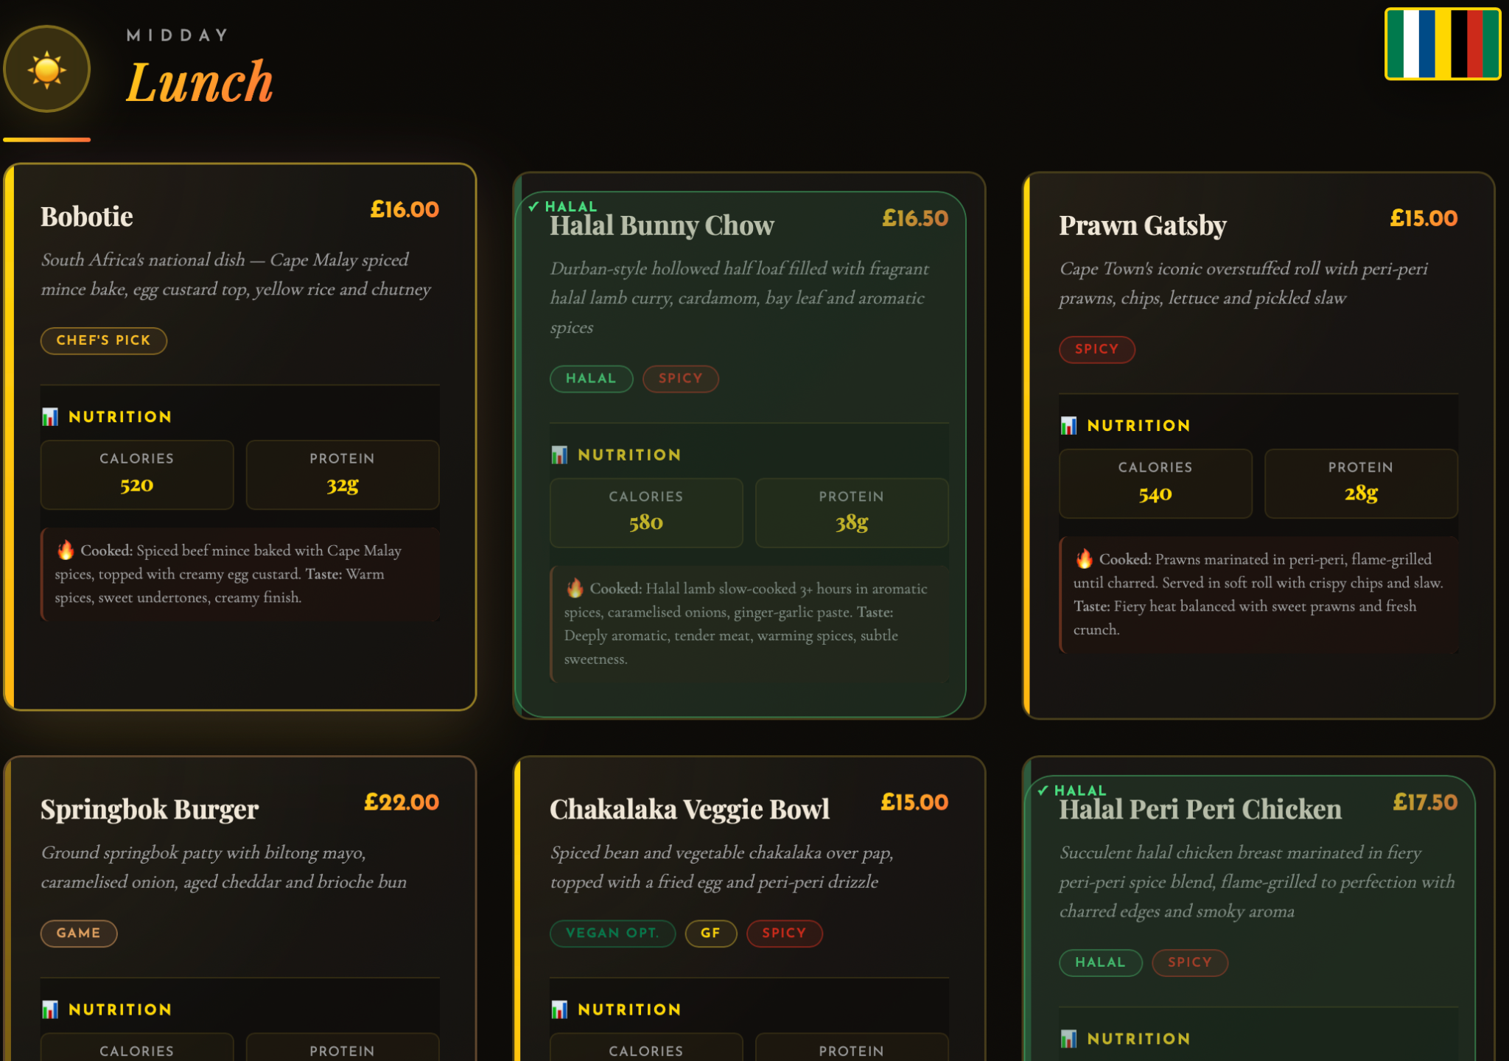
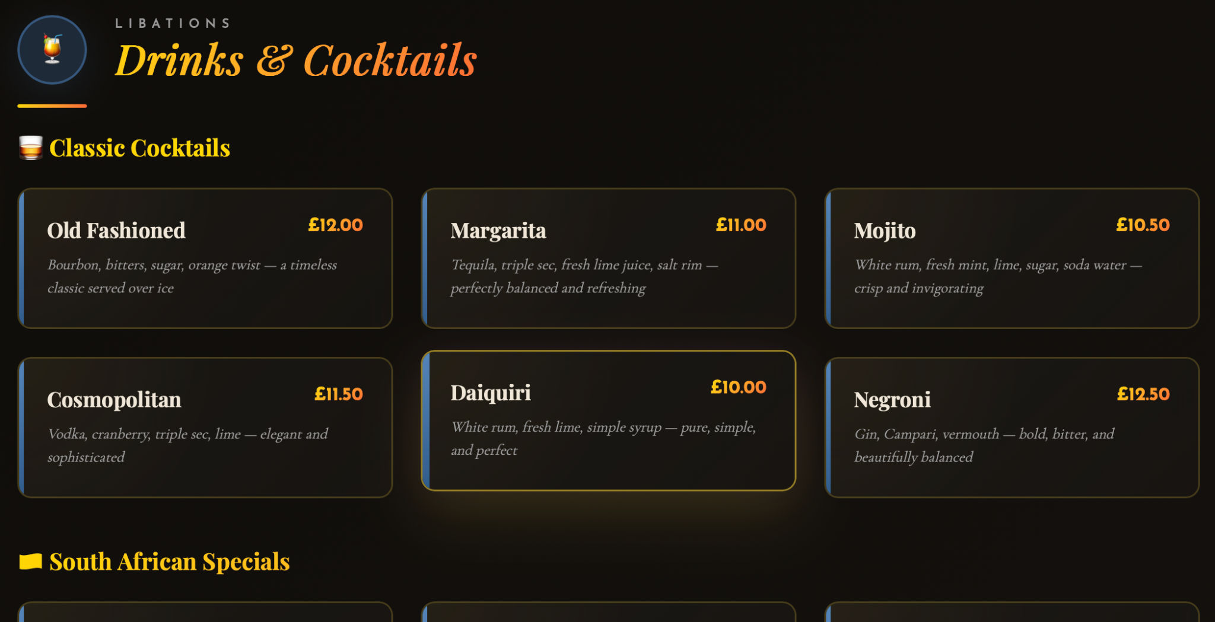
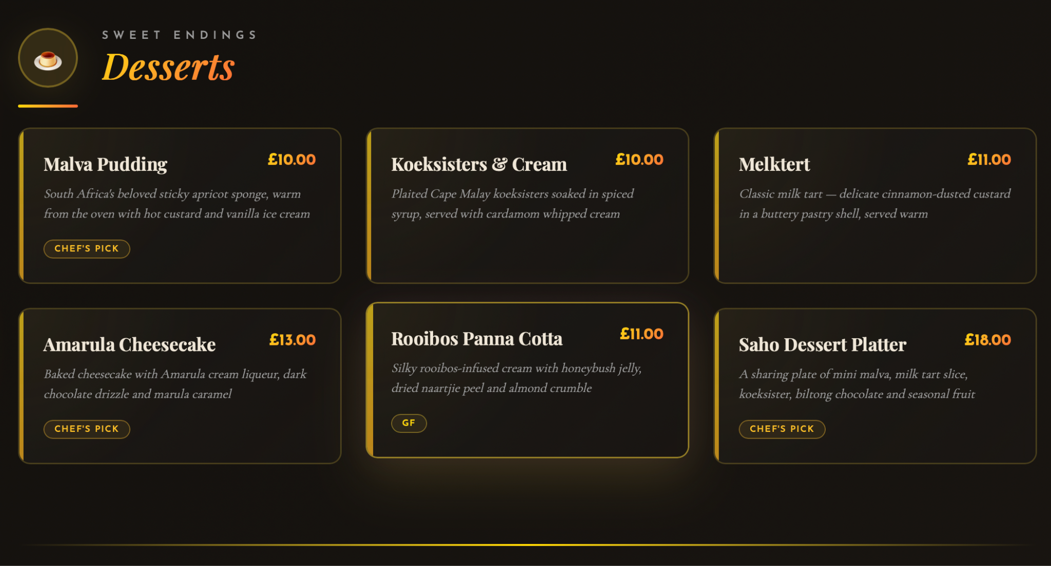
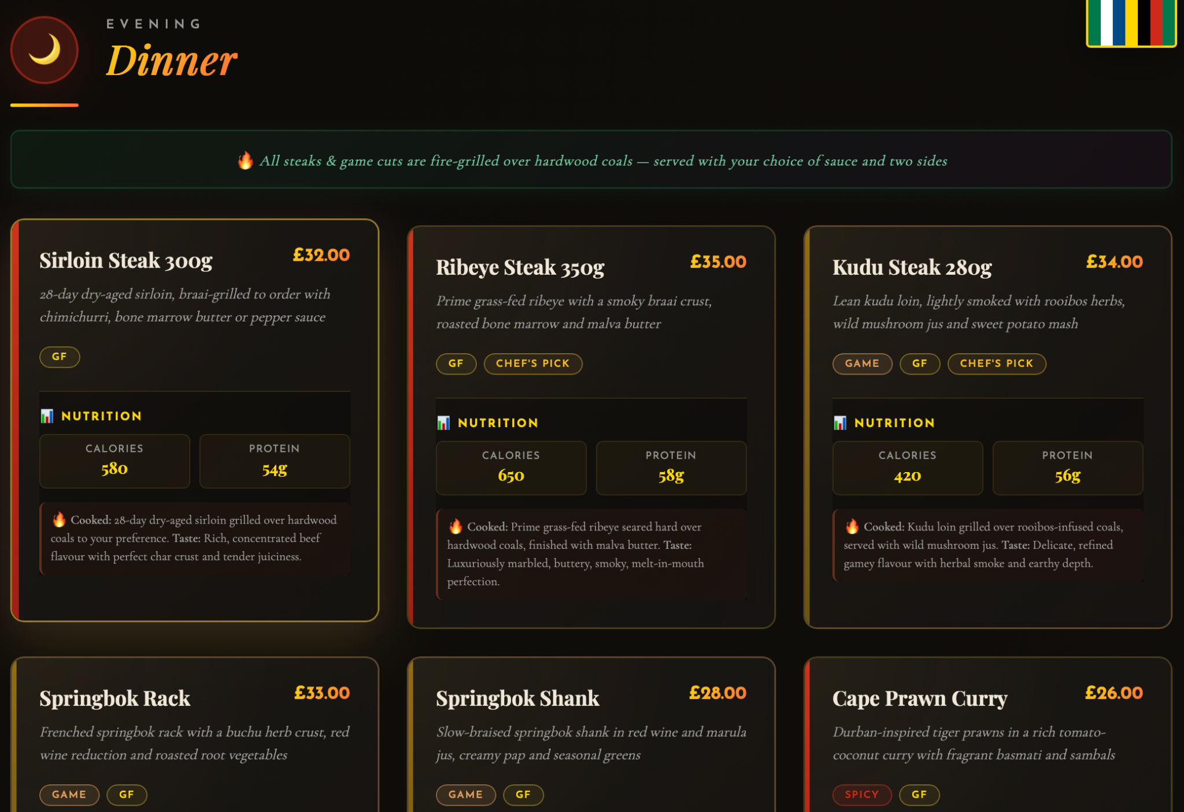
Our Menu
Notes:
The menu has all the traditional south african dishes and cuisine and much meat and grill with nutritious sides. With halal meat options and allergy alerts, our menu is designed to be inclusive for all. All cocktails and dessert to choose from and different dinner and lunch menus with starters and kids menu.

Slide 4
Mock Website
Our innovative, creative and skilled team tactically inputted prompts into an Artificial Intelligence and created a fully functional mock website that we will base our final design on.
https://sahokitchen-5ujrfmt6.manus.space/
Notes:
This is a link for the website that our menu designer made.

Slide 5
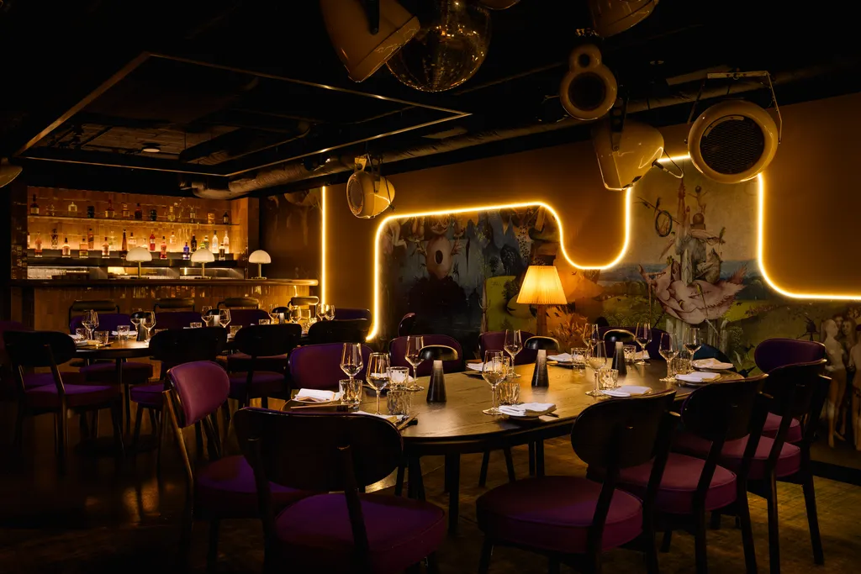
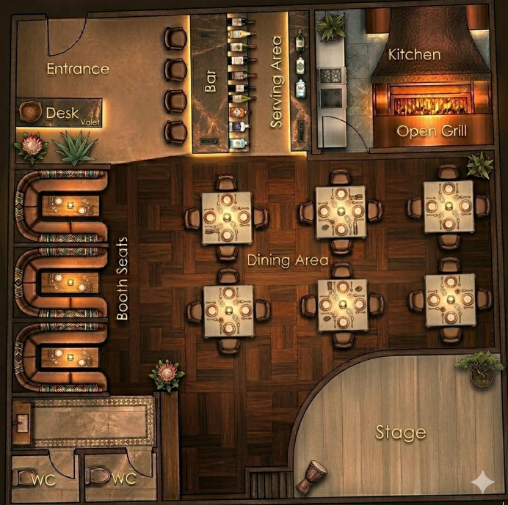
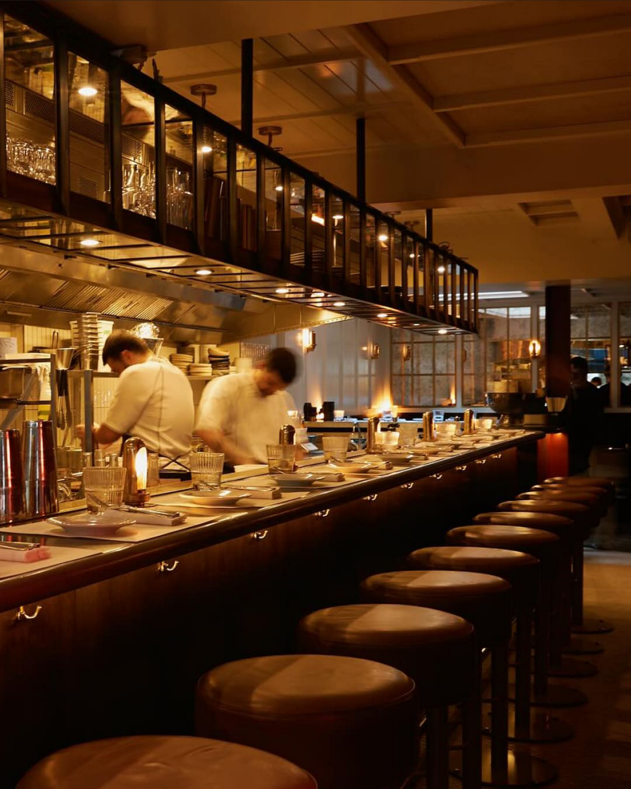
Our Restaurant
Notes:
This is our homely and rustic design of restaurant with an open kitchen and grill with lots of space to sit and a stage for live bands and events. Also a bar to have cocktails and drinks whilst waiting. Some images of inspiration on the right.

Slide 6

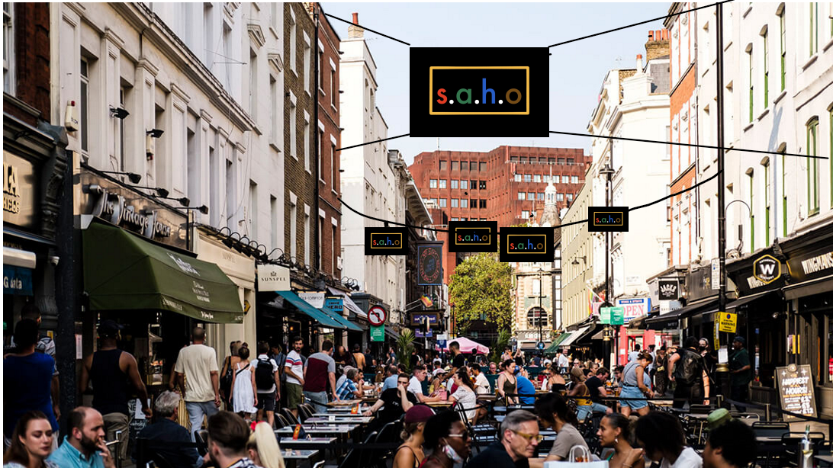
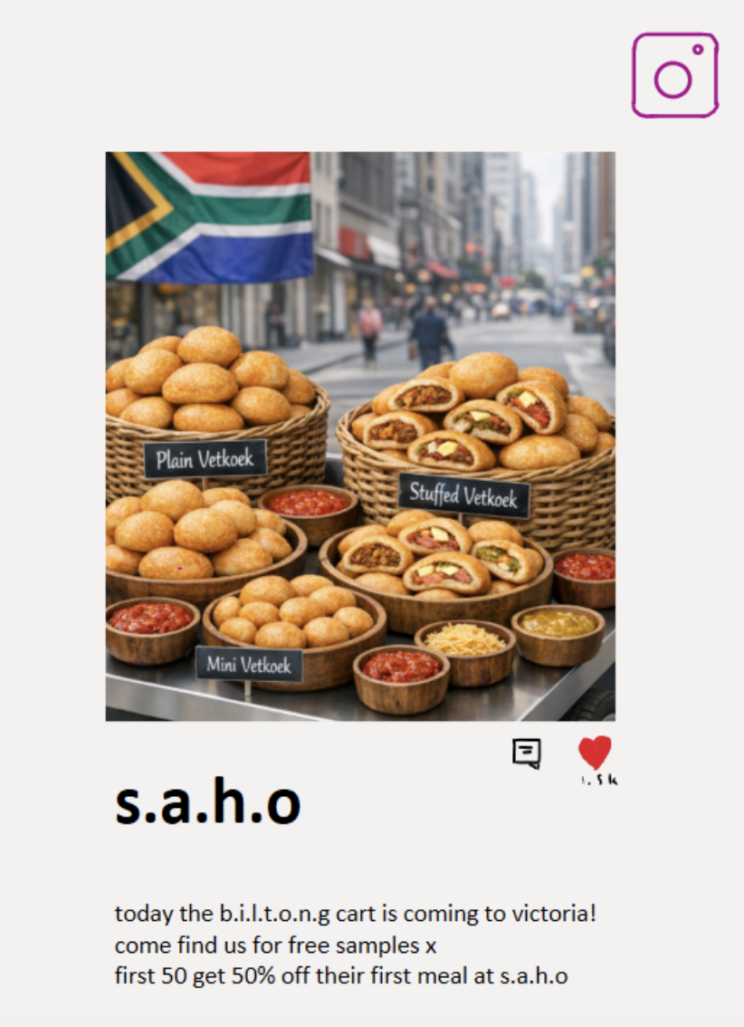

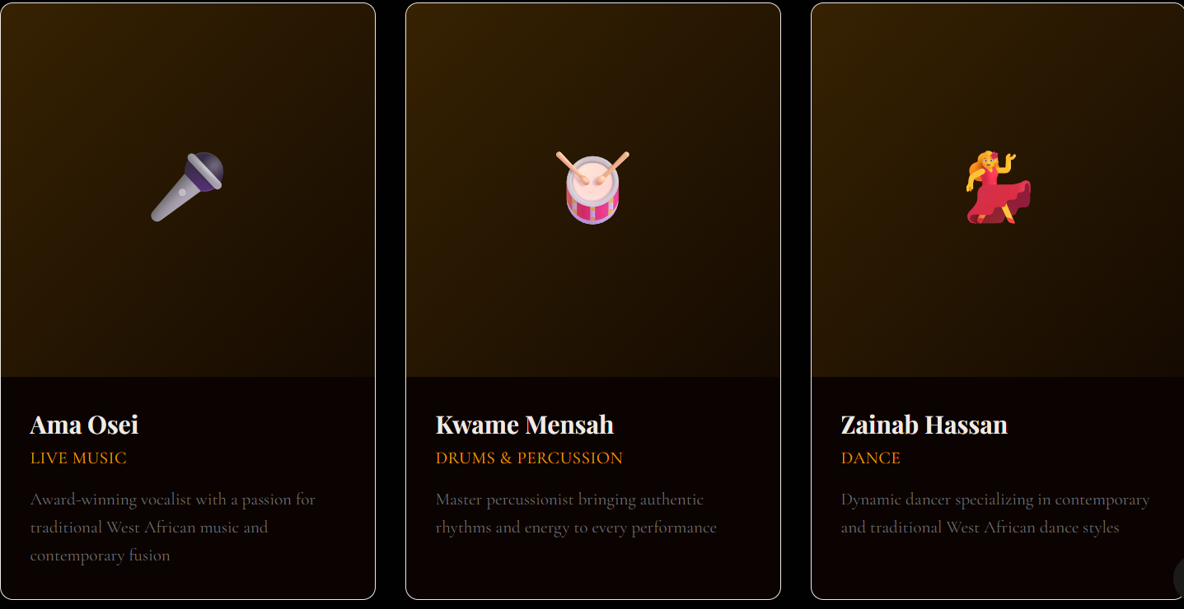
Our Advertising Strategy
External
Biltong Bicycle around London, free samples offered to general public
Presence at food markets - stalls and Biltong Bicycle present
Logo sculpture built in Central Soho, flags and posters with logos hung in Soho
Internal
Biltong Cart in the restaurant, customers can take biltong home
South African art incorporated into the decor
Art + Food Bundles
Social Media
Accounts on Instagram, TikTok, etc.
Videos of restaurant and get food reviewers to visit.
Signature dish: Bunny Chow — Bread Bowl Trend
Potential Endorsers = Faf de Klerk (rugby), Chané Grobler (influencer), Tyla (singer).
Notes:
Our main aims for advertising is for our biltong bike and live events at our restaurant. Our Biltong bike would take a ride through london giving out samples to people to promote our restaurant. We would also have south african singers and sport people like faf de klerk and tyla to get our restaurant popular and well known. As well as setting up social media accounts. Also live authentic music in our restaurants to bring south africa to our restaurants further.. Also banners and signs through soho.

Slide 7
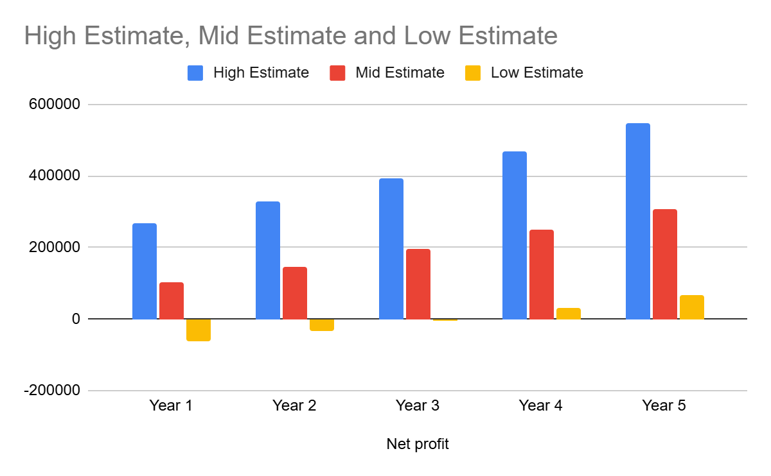
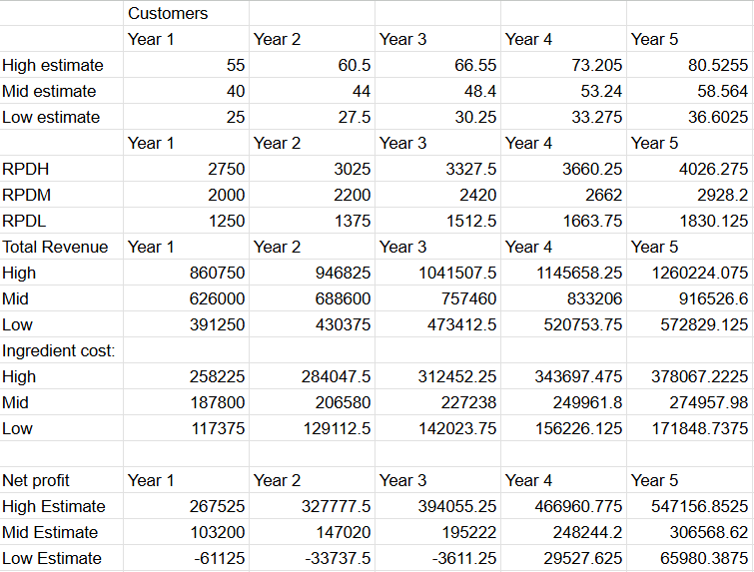
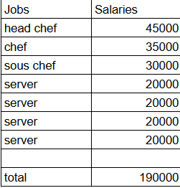
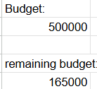
Our Projected Growth
Notes:
Here is our projected growth
We made three estimates, high mid and low
In each estimate we started with a certain number of customers
In the high we started with 125, mid with 100, and low with 75 which matches the footfall in soho
Each year the number grew by 10%
We calculated our revenue per day by multiplying the number of customers per day by average cost per person 25 pounds
Then total revenue which is revenue per day multiplied by 313 which is the number of days we work. We take Mondays off
Then ingredient cost is 30% of menu prices
We then took away salary and rent from revenue to calculate profit
Remaining budget after 1st year was calculated by subtracting fixed costs such as salaries and rent from budget

Slide 8


Our Sustainability Plan
Our Main Plan:
S.A.H.O will partner with charities that specifically aid South African people, we plan to partner with Food Forward SA as they fight food waste and hunger. A small percentage of our profits (around 5%) will go to this charity and there will also be a QR code on each table encouraging donations from people.
More sustainable ideas:
Ethical Food
Locally sourced ingredients where possible
Free-range, high-welfare meat (high-end restaurant)
Fairtrade South African imports
Low Environmental Impact
Energy-efficient kitchen and lighting
Renewable energy use
Water-saving systems
Notes:
We will make sure we work with charities to reduce our food waste and help feed people in south africa. Also making sure our kitchen and energy is sustainable and efficient eventually hoping to use solar panels. But to start we will work with these charities to help them and support them.

Slide 9
Why Choose Us

